Slide 1

Analysis of National Health Interview Survey Data
Chris Moriarity
National Conference on Health Statistics
August 18, 2010
cdm7@cdc.gov

Slide 2
Presentation outline
National Health Interview Survey (NHIS) overview
NHIS estimates and variance estimates
Analysis methods for pooled (combined annual samples) NHIS data – need to account for year-to-year correlation
Analysis of multiply imputed income data

Slide 3
The National Health Interview Survey (NHIS)
Conducted continuously nationwide since July 1957
Personal visit interview protocol, collecting data on a broad range of health topics
NHIS home page URL:
www.cdc.gov/nchs/nhis.htm

Slide 4
Estimates from NHIS data
NHIS has a complex sample design, including higher sampling rates of certain groups (black, Hispanic, Asian persons) - sampling weights should be used to make estimates from NHIS data
Variance estimation procedure must take account of complex sample design in order to be valid

Slide 5
Software for NHIS variance estimation
Reference: excellent Web page maintained by Alan Zaslavsky
http://www.hcp.med.harvard.edu/
statistics/survey-soft/
Software list, comparative summaries, review articles

Slide 6
Software package list at Alan's website
AM Software free American Inst. for Research
Bascula $ Statistics Netherlands
CENVAR free U.S. Bureau of the Census
CLUSTERS free University of Essex
Epi Info free Centers for Disease Control
GES $ Statistics Canada
IVEware free University of Michigan
PCCARP $ Iowa State University
R survey free www.r-project.org
SAS/STAT $ SAS Institute
SPSS $ SPSS
Stata $ Stata Corporation
SUDAAN $ Research Triangle Institute
VPLX free U.S. Bureau of the Census
WesVar $ Westat, Inc.

Slide 7
Variance estimation guidance at NHIS methods page - 1963 to 2009
www.cdc.gov/nchs/nhis/methods.htm
SUDAAN, Stata, R survey, SAS survey procedures, SPSS, VPLX: Sample code provided for use with NHIS data
SAS, SPSS: Guidance provided to avoid problems with missing DOMAIN/SUBPOP variables in analyses of NHIS data

Slide 8
NHIS year-to-year correlation: why?
The U.S. counties (PSUs) selected at the beginning of a sample design period remain the same for the entire sample design period
Consecutive annual sample cases tend to be close together geographically - they tend to have similar characteristics

Slide 9
Year-to-year correlation over a ~10 year sample design period
Correlation is present during the entire sample period
Correlation may be less for annual samples years apart than for annual samples closer together

Slide 10
Year-to-year correlation example: Census Region population totals (4)
Available for all years NHIS microdata are available; Census Region consistently defined
Reasonable to expect high level of correlation for adjacent years, perhaps a decline over time

Slide 11
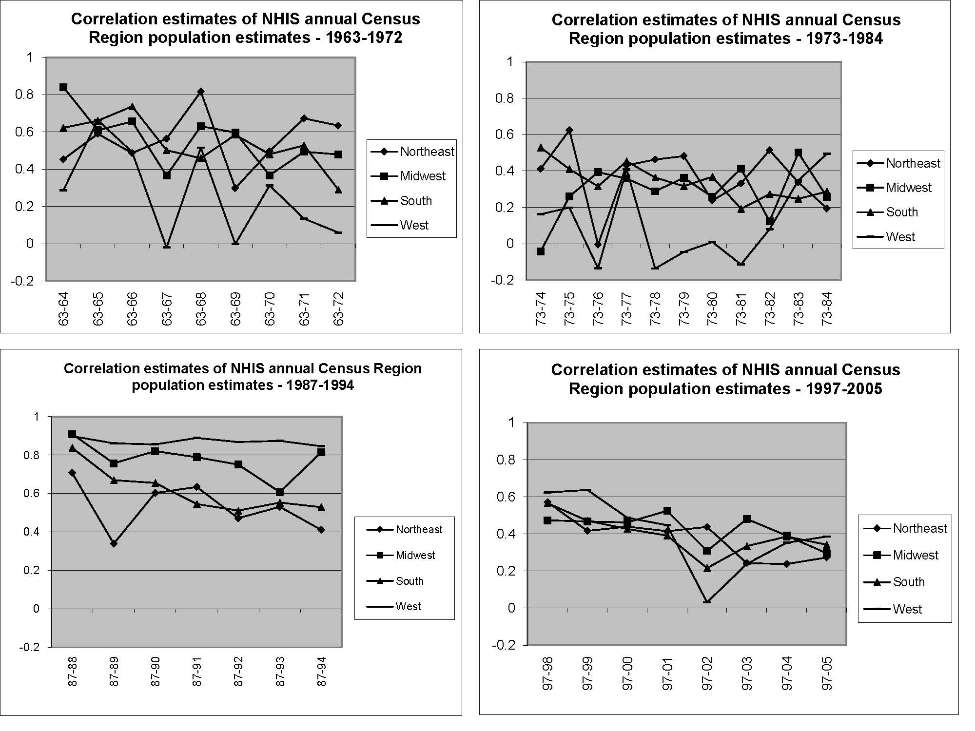

Slide 12
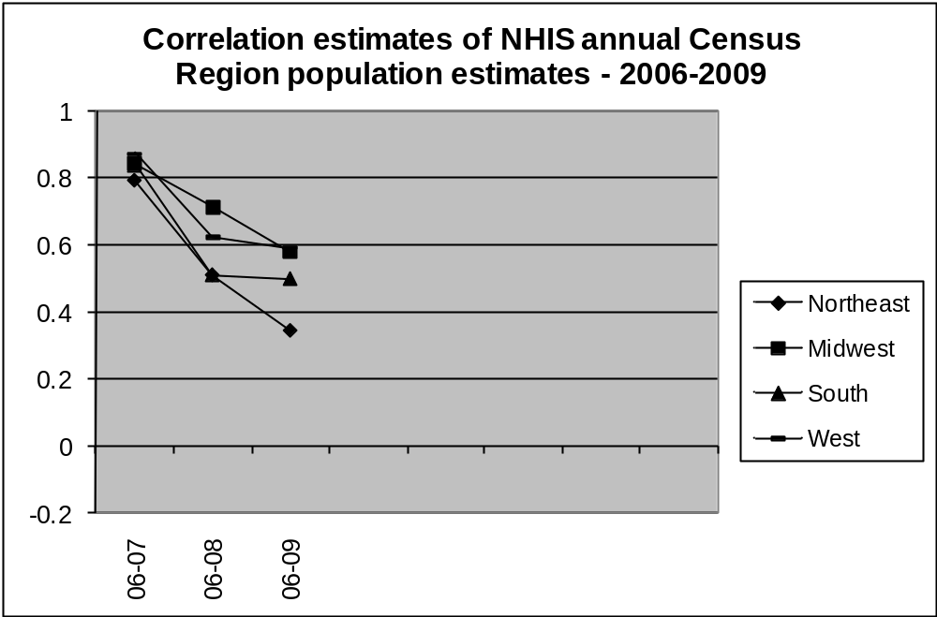

Slide 13
Variance estimation guidance for combined (pooled) analyses
Documentation for public use files available online at NHIS methods page: www.cdc.gov/nchs/nhis/methods.htm
Refer also to appendix "Merging Data Files and Combining Years of Data in the NHIS" in the annual NHIS survey description document, part of annual NHIS public use file data release

Slide 14
Variance estimation for pooled annual samples
Annual samples within a sample design period are not statistically independent
Annual samples in different sample design periods are (essentially) statistically independent

Slide 15
Variance estimation within a sample design period (dependent)
Treat pooled annual samples like one big annual sample for variance estimation
No recoding of variance estimation variables required

Slide 16
Variance estimation across sample design periods (independent)
Need to recode variance estimation stratum variables in different sample design periods to make sure they are different
Variance estimation stratum variable values always are <1000; use this fact when recoding

Slide 17
Variance estimation across sample design periods - recodes
Construct a new variance estimation stratum variable from existing variables by adding 1000 in one design period, 2000 in the next design period, etc.
This guarantees the values will be distinct in different design periods

Slide 18
Variance estimation for both "within" and "across"
Example: a 2004-2008 pooled analysis
Conceptually, the "within" step comes first: 2004-2005 in one sample design period, 2006-2008 in a different sample design period

Slide 19
Variance estimation for both "within" and "across" (continued)
Conceptually, the "across" step follows the "within" step: do recoding of variance estimation strata variables across the sample design periods (2004-2005 versus 2006-2008) while combining the five annual datasets into one pooled dataset

Slide 20
Recommended weight adjustment for all pooled analyses
Divide weights by the number of years being pooled - simple and defensible
Example: 2004-2008 pooled analysis (5 years): divide weights by 5

Slide 21
More sophisticated weight adjustment for pooled analyses
A user focusing on a particular pooled estimate may prefer a weight adjustment designed to minimize the estimate's variance
If sample sizes stable: both methods (simple, sophisticated) usually give similar weights

Slide 22
Before doing a pooled analysis - need to check data are similar
Analyses of pooled data are meaningful only when the data being pooled are similar
Question wording the same? Answer categories the same? Same target population?

Slide 23
1968: a special case for pooled analyses
There are 1968 calendar year and 1968 fiscal year (July 1967-early July 1968) data files; overlap of 67,608 persons
The overlap (January-early July 1968) should be removed for a pooled analysis that includes both fiscal and calendar 1968 data

Slide 24
Imputed NHIS income data
High item nonresponse to income questions
1990-6: hot deck single imputation
1997-present: multiple imputation (5 imputations)

Slide 25
1990-6 imputed data
Imputed items have allocation flags which allow identification of imputed data
No simple method available to estimate uncertainty from imputation process

Slide 26
1997-present imputed data
Imputed items have allocation flags which allow identification of imputed data
Can use Rubin’s method to estimate uncertainty from imputation process

Slide 27
New 1997-present imputed data
New files contain multiply-imputed values, not just ranges, for family income and personal earnings
Top ~5% of values are top-coded
Already released for 2008, releases for 1997-2007 and 2009 are coming soon

Slide 28
Correct analysis of multiply imputed data
Carry out analysis for each imputation
Combine results of analyses to obtain final result

Slide 29
Incorrect analyses of multiply imputed data
Pick just 1 imputation and do 1 analysis
Take the average of the imputations and do 1 analysis

Slide 30
Combining results of analyses
Can do manually, e.g., by writing a SAS macro program
Can do with software such as SAS PROC MIANALYZE, mitools R package
Can do analysis and combination automatically with software such as mi estimate in Stata, mi_files, mi_count in SUDAAN, etc.

Slide 31
Example: 2006 family income
Pick just 1 imputation (incorrect): $55,583, s.e. $601
Take the average of the imputations and do 1 analysis (incorrect): $55,376, s.e. $599
Correct: $55,376, s.e. $642

Slide 32
Summary
Weights should be used in analyses of NHIS data
Variance estimation requires care, particularly for subdomains
Annual NHIS samples are correlated within a sample design period; not correlated across sample design periods; pooled analyses need to account for correlation/lack of correlation
Analyses of multiply imputed data should follow the standard protocol in order to obtain appropriate estimates and uncertainty estimates

Slide 33
Year-to-year Correlation Reference
Moriarity, C. and Parsons, V.: Year-to-Year Correlation in National Health Interview Survey Estimates, Presented at the 2008 Joint Statistical Meetings
Available online at:
http://www.amstat.org/Sections/Srms/Proceedings/y2008/Files/301235.pdf

